Slide 1
To detect high energy neutrinos from the cosmos
T.C. Liu
ElectroPhysics Department
National Chiao-Tung University

Slide 2
Outlines
What are neutrinos?
Where are neutrinos coming from?
How to detect neutrino?
Antarctic Impulsive Transient Antenna (ANITA)
Puzzle!!!

Slide 3
Elementary Particles
I. What are neutrinos
u
c
t
$$2/3$$
g
d
s
b
$$-1/3$$
e
$$-1$$
$$μ$$
$$τ$$
$$γ$$
He Atom
(Mass: 0.511MeV, charge:-1)
e
$$γ$$
~1 $\overset{·}{A}$ ~${10}^{-10}m$
u
g
p
n
n
p
d
d
Nucleus
~${10}^{-15}m$
n (Mass: 939MeV, charge:0)
u
g
u
d
p (Mass: 938.2MeV, charge:+1)

Slide 4
Interactions:
Conservation law
I. What are neutrinos
u
c
t
$$2/3$$
g
d
s
b
$$-1/3$$
e
$$-1$$
$$μ$$
$$τ$$
$$γ$$
$e^{-}$
$e^{-}$
$e^{-}$
$$γ$$
$$γ$$
$e^{-}$
$e^{-}$
$e^{+}$
$$γ$$
Møller scattering
Pair production
Energy
Momentum
Angular momentum
Spin
Lepton number
Baryon number
$$γ$$
$$γ$$
$e^{-}$
$e^{-}$
Compton scattering

Slide 5
Interactions:
Conservation law
I. What are neutrinos
u
c
t
$$2/3$$
g
d
s
b
$$-1/3$$
e
$$-1$$
$$μ$$
$$τ$$
$$γ$$
Energy
Momentum
Angular momentum
Spin
Lepton number
Baryon number

Slide 6
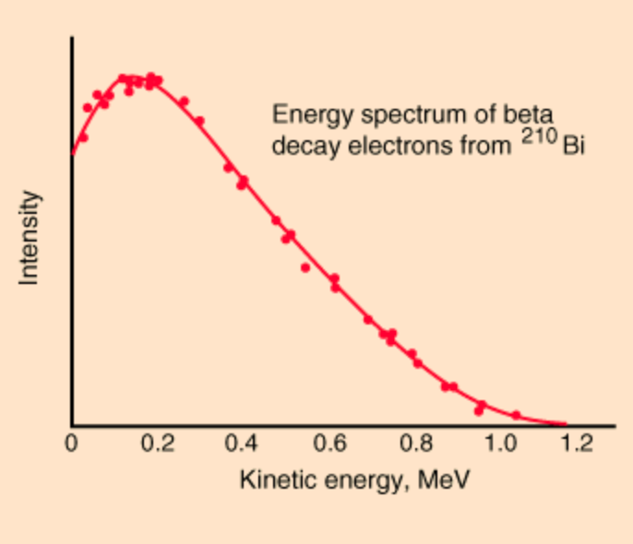
Interactions:
Conservation law
I. What are neutrinos
u
c
t
$$2/3$$
g
d
s
b
$$-1/3$$
e
939 MeV 938 MeV 0.511 MeV
$$-1$$
$$μ$$
$$τ$$
$$γ$$
n $→$ p + $e^{-}$
+$\overline{ν_{e}}$
0
$ν_{e}$
$ν_{μ}$
$ν_{τ}$
$$W^{+},W^{-},Z^{0}$$
n
p
u
u
d
d
d
u
Intensity
$e^{-}$
Energy
Momentum
Angular momentum
Spin
Lepton number
Baryon number
$$W^{-}$$
$\overline{ν_{e}}$
Beta decay
Kinetic energy (MeV)

Slide 7
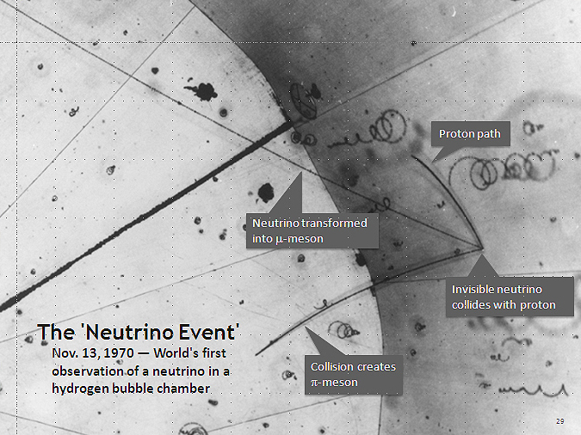
Neutrinos
I. What are neutrinos
The first use of a hydrogen bubble chamber to detect neutrinos, on November 13, 1970. A neutrino hit a proton in a hydrogen atom. The collision occurred at the point where three tracks emanate on the right of the photograph.

Slide 8
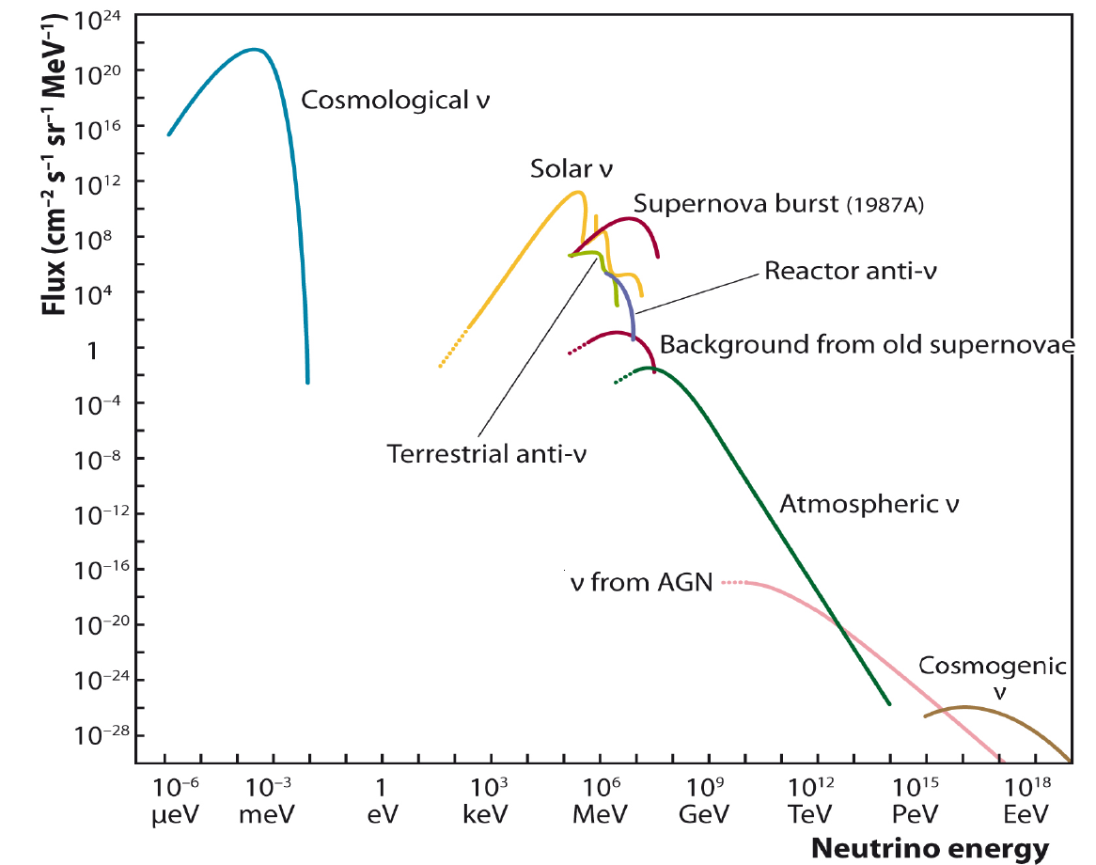
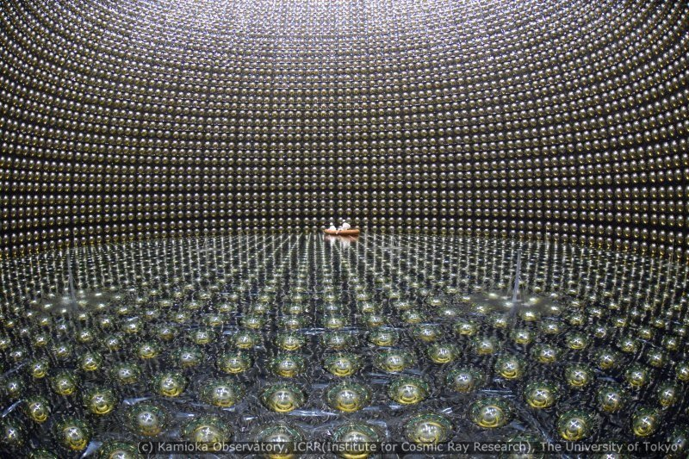
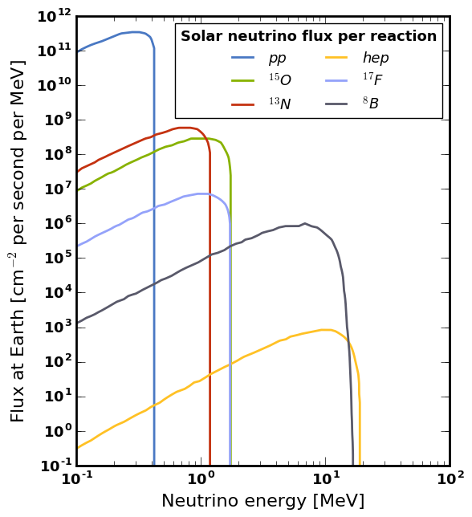
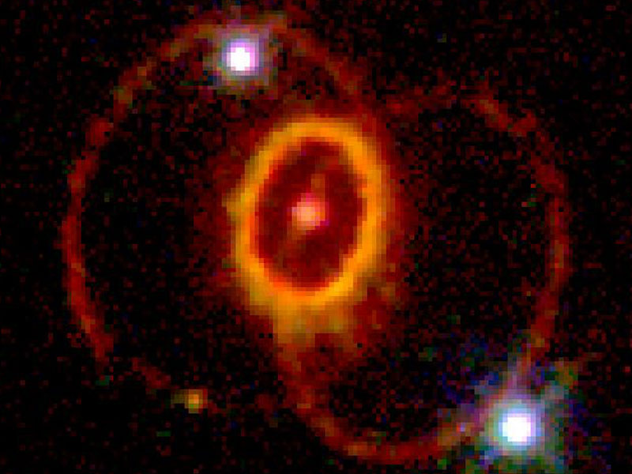
II. Where are neutrinos coming from?
From IceCube collaborations
Cosmological Neutrino Background:
1.9 K
2 seconds after big bang
Solar Neutrinos:
400 keV ~20 MeV
~$7*{10}^{7}$ /$mm^{2}$/sec on Earth
Supernova Neutrinos:
~ MeV
小柴昌俊1926-2020/11/12

Slide 9
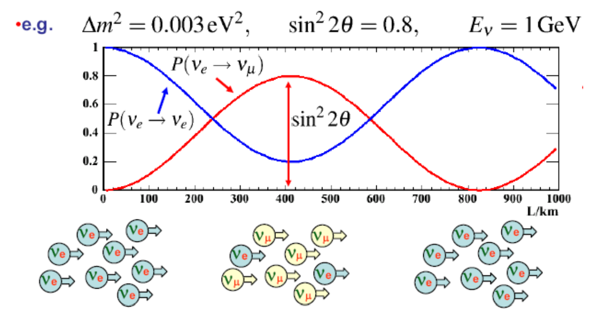
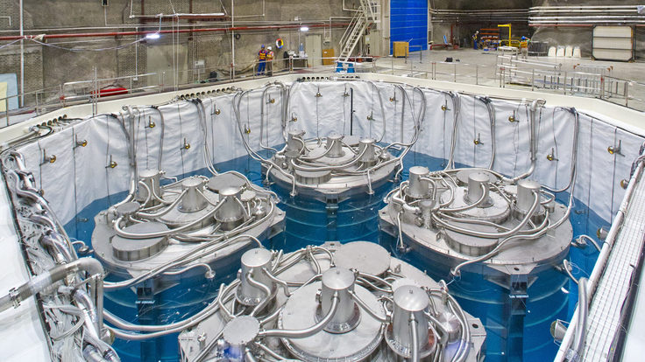
II. Where are neutrinos coming from?
From IceCube collaborations
Cosmological Neutrino Background:
1.9 K
2 seconds after big bang
Solar Neutrinos:
400 keV ~20 MeV
~$7*{10}^{7}$ /$mm^{2}$/sec on Earth
Supernova Neutrinos:
~ MeV
Reator Neutrons:
~ MeV
From Mark Thomson
From DUNE

Slide 10
II. Where are neutrinos coming from?
Cosmological Neutrino Background:
1.9 K
2 seconds after big bang
From IceCube collaborations
Solar Neutrinos:
400 keV ~20 MeV
~$7*{10}^{7}$ /$mm^{2}$/sec on Earth
Supernova Neutrinos:
~ MeV
Reator Neutrons:
~ MeV
Atmospheric Neutrons:
MeV ~0.1 PeV

Slide 11
II. Where are neutrinos coming from?
Cosmic rays
Cosmological Neutrino Background:
1.9 K
2 seconds after big bang
Air molecule
$$π^{0}$$
$$N$$
Solar Neutrinos:
400 keV ~20 MeV
~$7*{10}^{7}$ /$mm^{2}$/sec on Earth
$$π^{+}$$
$$π^{-}$$
$$γ$$
$$γ$$
$$p$$
$$p$$
$$n$$
Supernova Neutrinos:
~ MeV
$$p$$
$$n$$
Reator Neutrons:
~ MeV
$$e^{+}$$
$$e^{-}$$
Atmospheric Neutrons:
MeV ~${10}^{14}eV$
$$μ^{+}$$
$$μ^{-}$$
$$ν_{μ}$$
$$\overline{ν_{μ}}$$

Slide 12
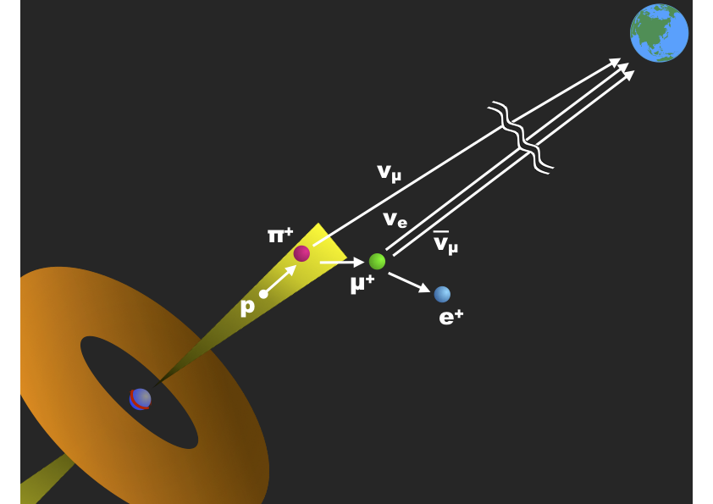
II. Where are neutrinos coming from?
Cosmological Neutrino Background:
1.9 K
2 seconds after big bang
From IceCube collaborations
Solar Neutrinos:
400 keV ~20 MeV
~$7*{10}^{7}$ /$mm^{2}$/sec on Earth
Supernova Neutrinos:
~ MeV
Reator Neutrons:
~ MeV
Atmospheric Neutrons:
MeV ~${10}^{14}eV$
AGN:
GeV ~
From Super-Kamiokande collaborations
Cosmogenic neutrino:
PeV ~

Slide 13
II. Where are neutrinos coming from?
Cosmological Neutrino Background:
1.9 K
2 seconds after big bang
$$p(E>{10}^{19.6}eV)+γ_{CMB}→Δ^{+}→n+π^{+}$$
Solar Neutrinos:
400 keV ~20 MeV
~$7*{10}^{7}$ /$mm^{2}$/sec on Earth
p: Cosmic rays(${10}^{19.6}eV$)
Supernova Neutrinos:
~ MeV
$$Δ^{+}$$
Reator Neutrons:
~ MeV
n
p
$e^{-}$
Atmospheric Neutrons:
MeV ~${10}^{14}eV$
$$π^{+}$$
AGN:
GeV ~
$\overline{ν_{e}}$
Cosmogenic neutrino:
PeV ~
$μ^{+}$
$ν_{μ}$
CMB

Slide 14
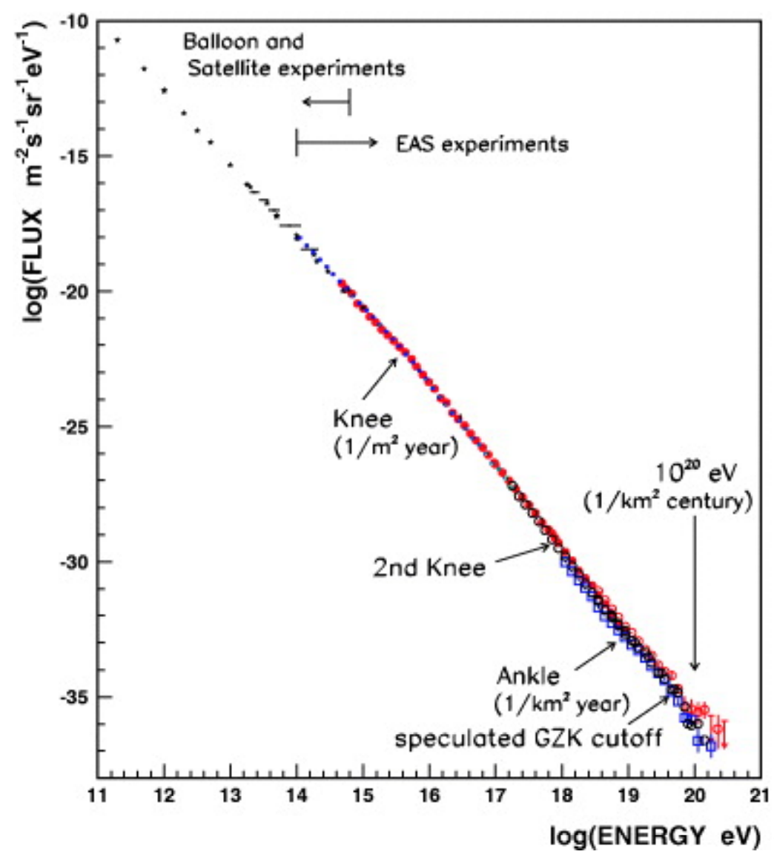
II. Where are neutrinos coming from?
Cosmological Neutrino Background:
1.9 K
2 seconds after big bang
Solar Neutrinos:
400 keV ~20 MeV
~$7*{10}^{7}$ /$mm^{2}$/sec on Earth
Supernova Neutrinos:
~ MeV
Reator Neutrons:
~ MeV
Atmospheric Neutrons:
MeV ~${10}^{14}eV$
AGN:
GeV ~
Cosmogenic neutrino:
PeV ~

Slide 15
III. How to detect neutrinos ?

Slide 16
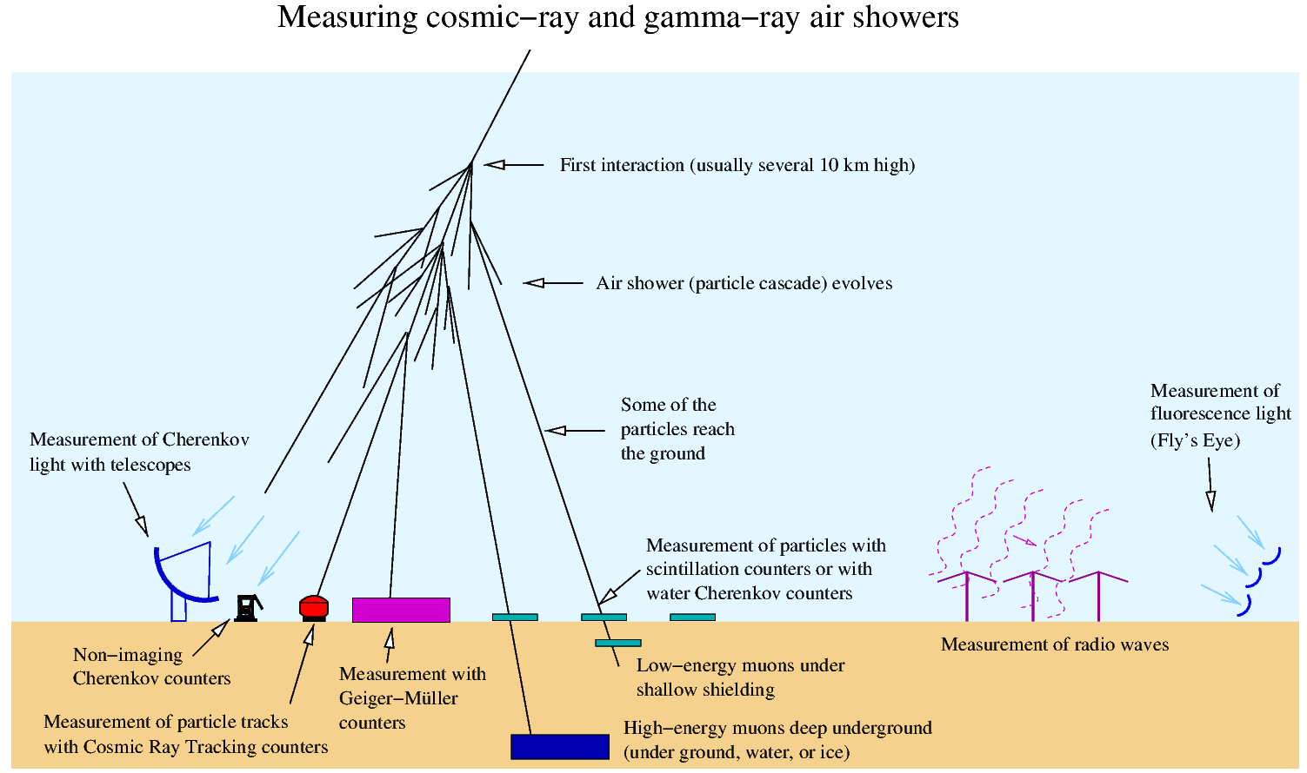
III. How to detect neutrinos ?
Start from CR

Slide 17
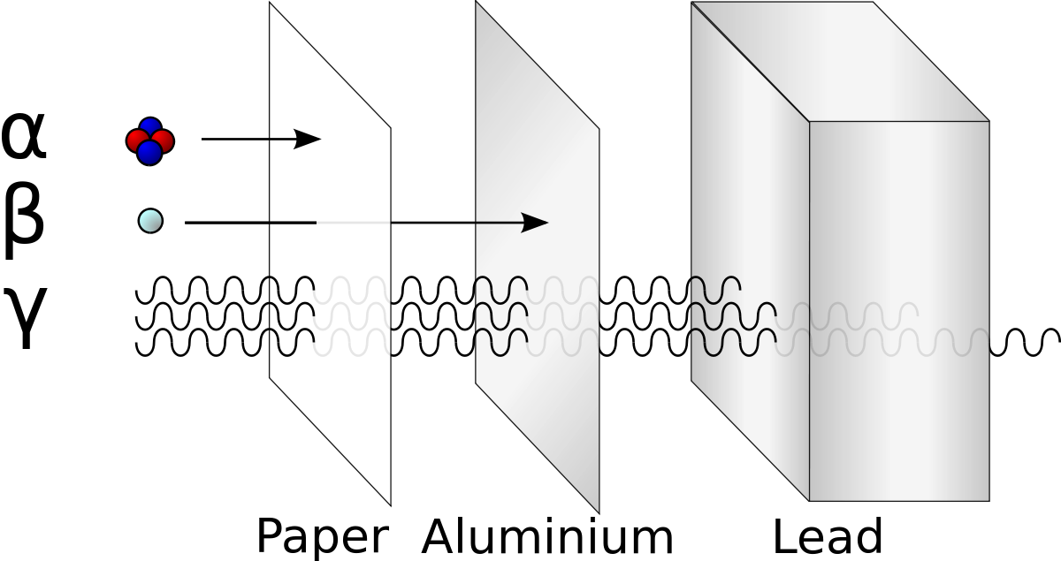
III. How to detect neutrinos ?
Neutrino interaction length
u
c
t
$$2/3$$
g
d
s
b
$$-1/3$$
e
$$-1$$
$$μ$$
$$τ$$
$$γ$$
0
$ν_{e}$
$ν_{μ}$
$ν_{τ}$
$$W^{+},W^{-},Z^{0}$$

Slide 18
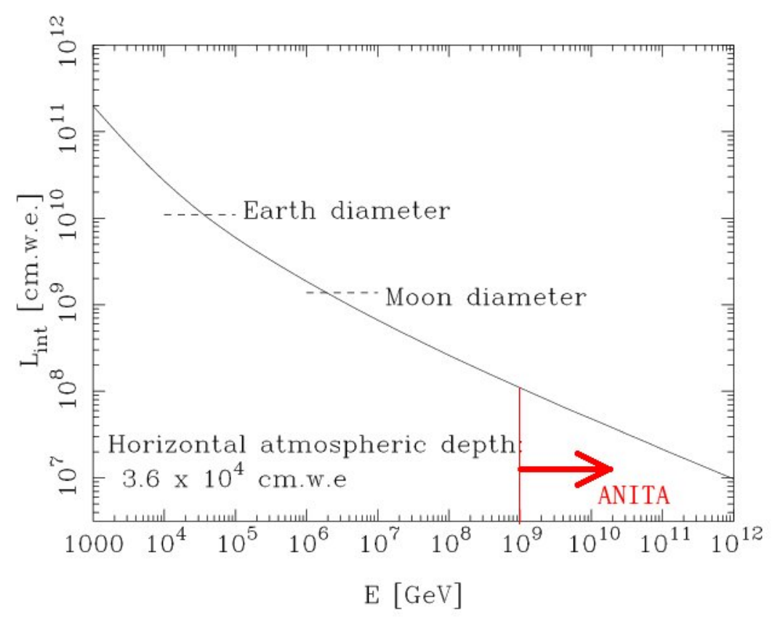
$L_{int}=\frac{1}{σ_{ν_{e}}(E_{ν})(10/18)N_{A}}$
III. How to detect neutrinos ?
Neutrino interaction length
u
c
t
$$2/3$$
g
1 TeV 2.5*${10}^{11}$ cm.we
d
s
b
$$-1/3$$
e
$$-1$$
$$μ$$
$$τ$$
$$γ$$
0
$ν_{e}$
$ν_{μ}$
$ν_{τ}$
$$W^{+},W^{-},Z^{0}$$
PhysRevD.58.093009

Slide 19
III. How to detect neutrinos ?
Neutrino interaction length
u
c
t
$$2/3$$
g
d
s
b
$$-1/3$$
e
$$-1$$
$$μ$$
$$τ$$
$$γ$$
0
$ν_{e}$
$ν_{μ}$
$ν_{τ}$
$$W^{+},W^{-},Z^{0}$$
Earth
$$ν$$

Slide 20
III. How to detect neutrinos ?
Neutrino interaction length
~600km
1 TeV 2.5*${10}^{11}$ cm.we
$$E_{ν}={10}^{13}eV$$
~3000km
$$E_{ν}={10}^{15}eV$$
~12000km
$$E_{ν}={10}^{18}eV$$

Slide 21
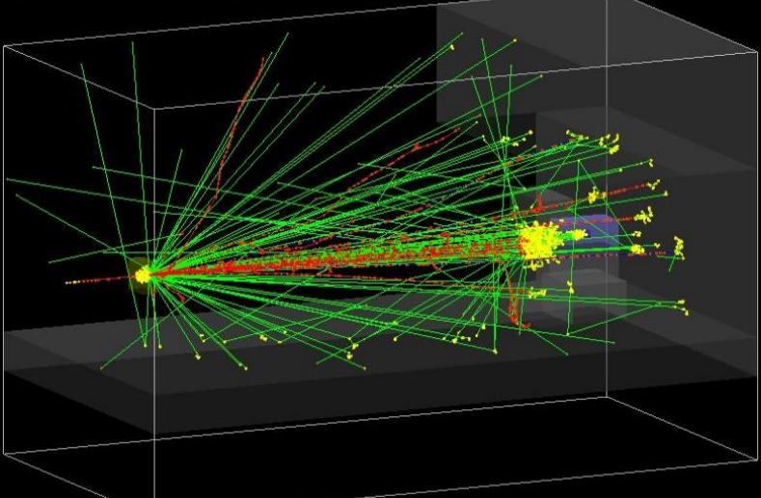
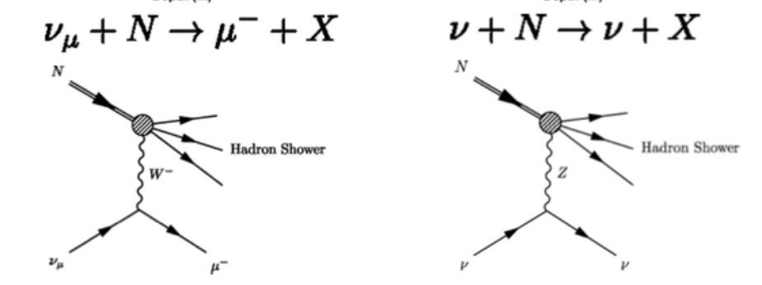
III. How to detect neutrinos ?
Interaction length of neutrino is too long.
It is too difficult to detect neutrinos directly.

Slide 22
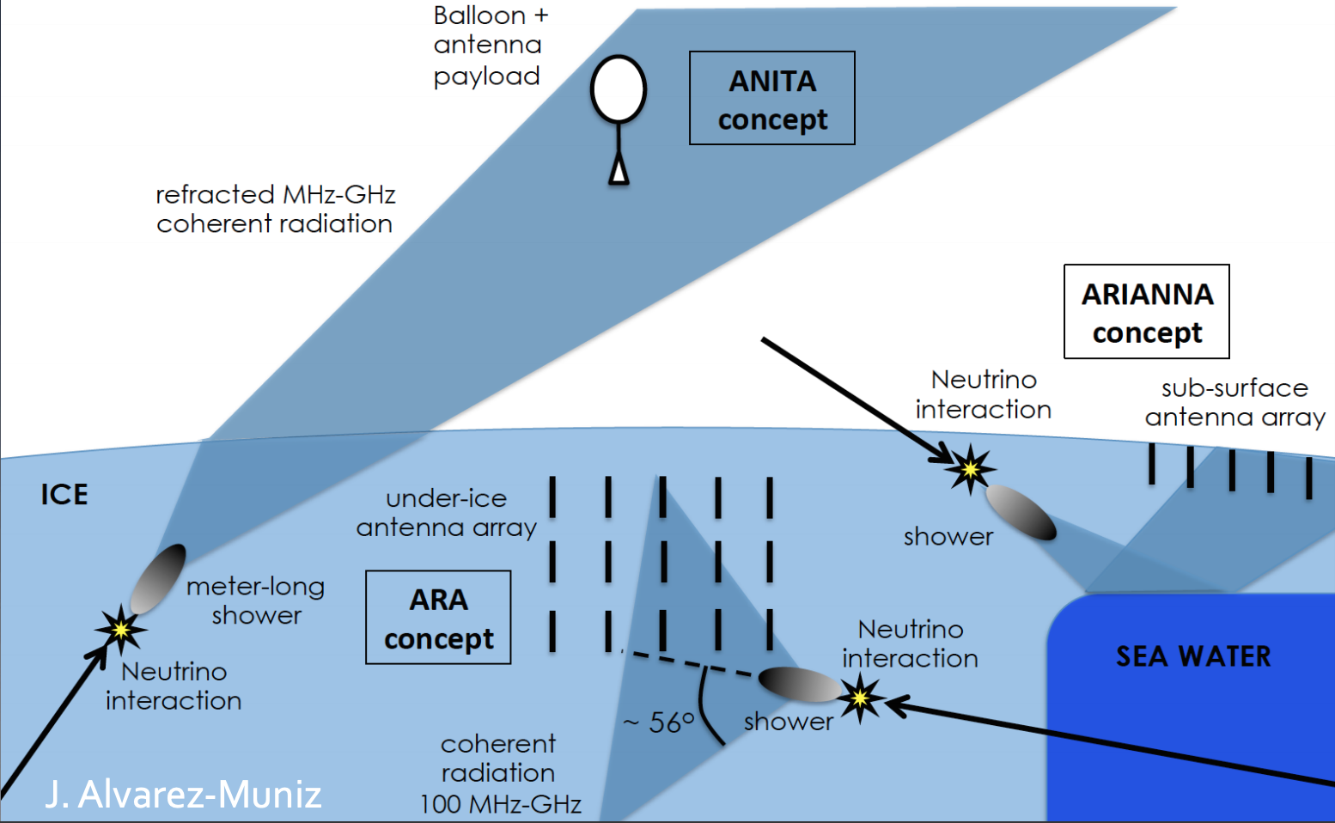
III. How to detect neutrinos ?
IceCube, ANITA, ARA, & ARIANNA
1 TeV 2.5*${10}^{11}$ cm.we

Slide 23
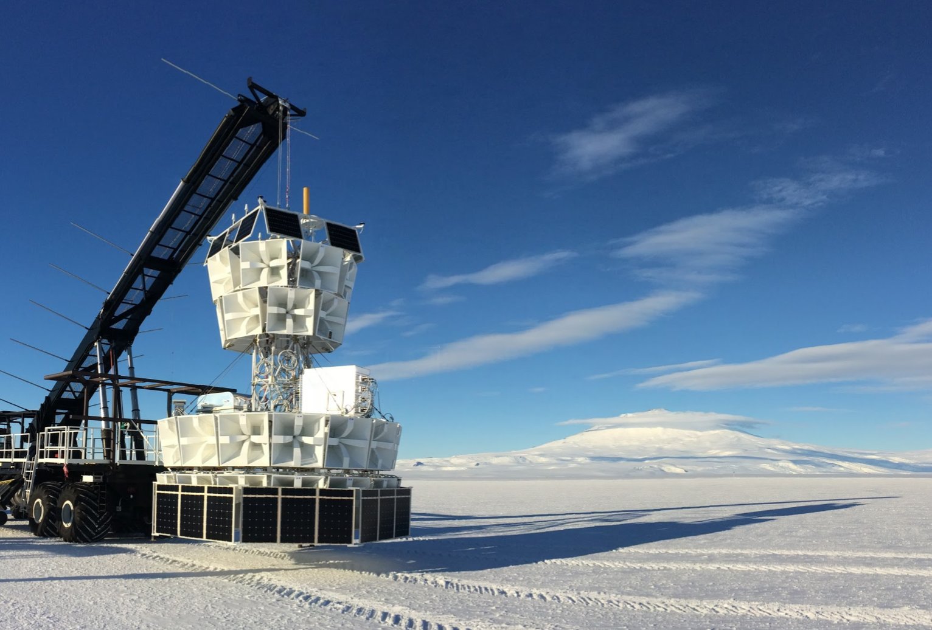
IV. ANITA
ANtarctic Impulsive Transient Antenna (ANITA)
1 TeV 2.5*${10}^{11}$ cm.we

Slide 24
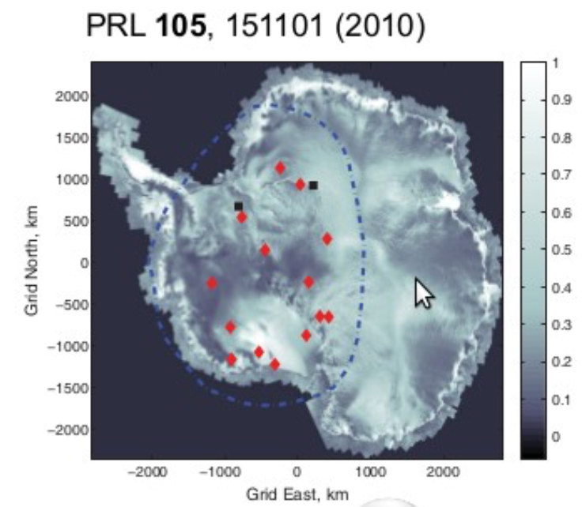
IV. ANITA
ANtarctic Impulsive Transient Antenna (ANITA)
Cosmic ray events
Cherenkov radiation
ANITA
<10km
Ice

Slide 25
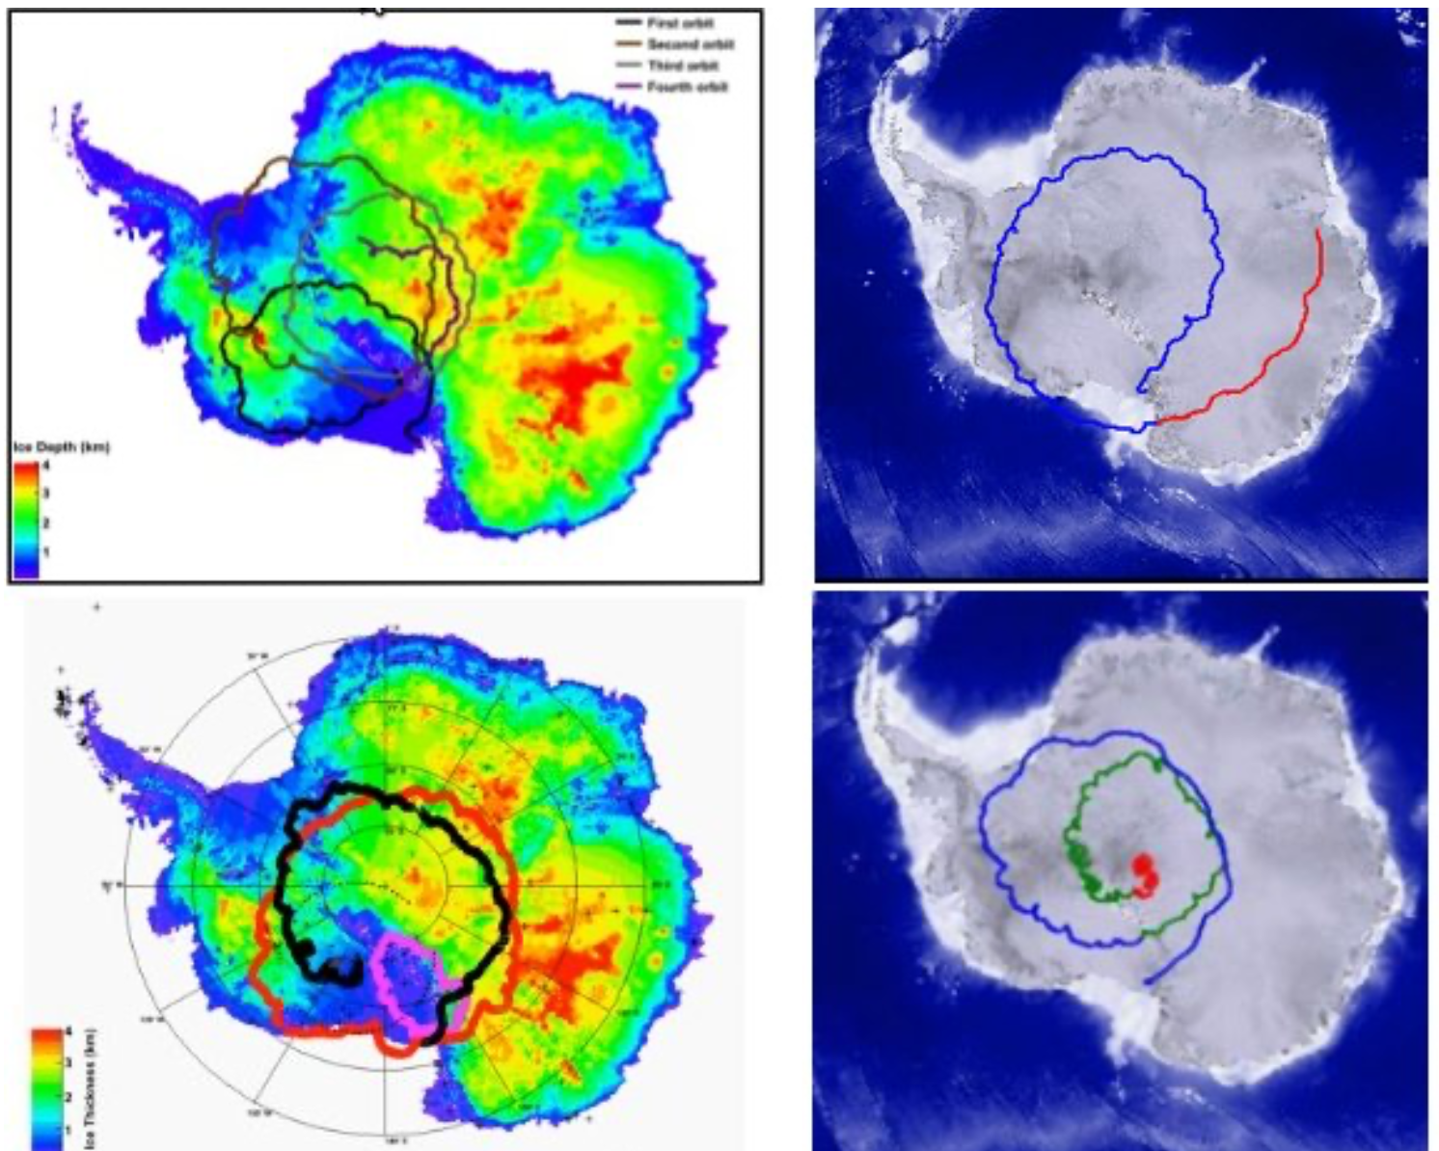
IV. ANITA
ANtarctic Impulsive Transient Antenna (ANITA)
Flight path
1 TeV 2.5*${10}^{11}$ cm.we

Slide 26
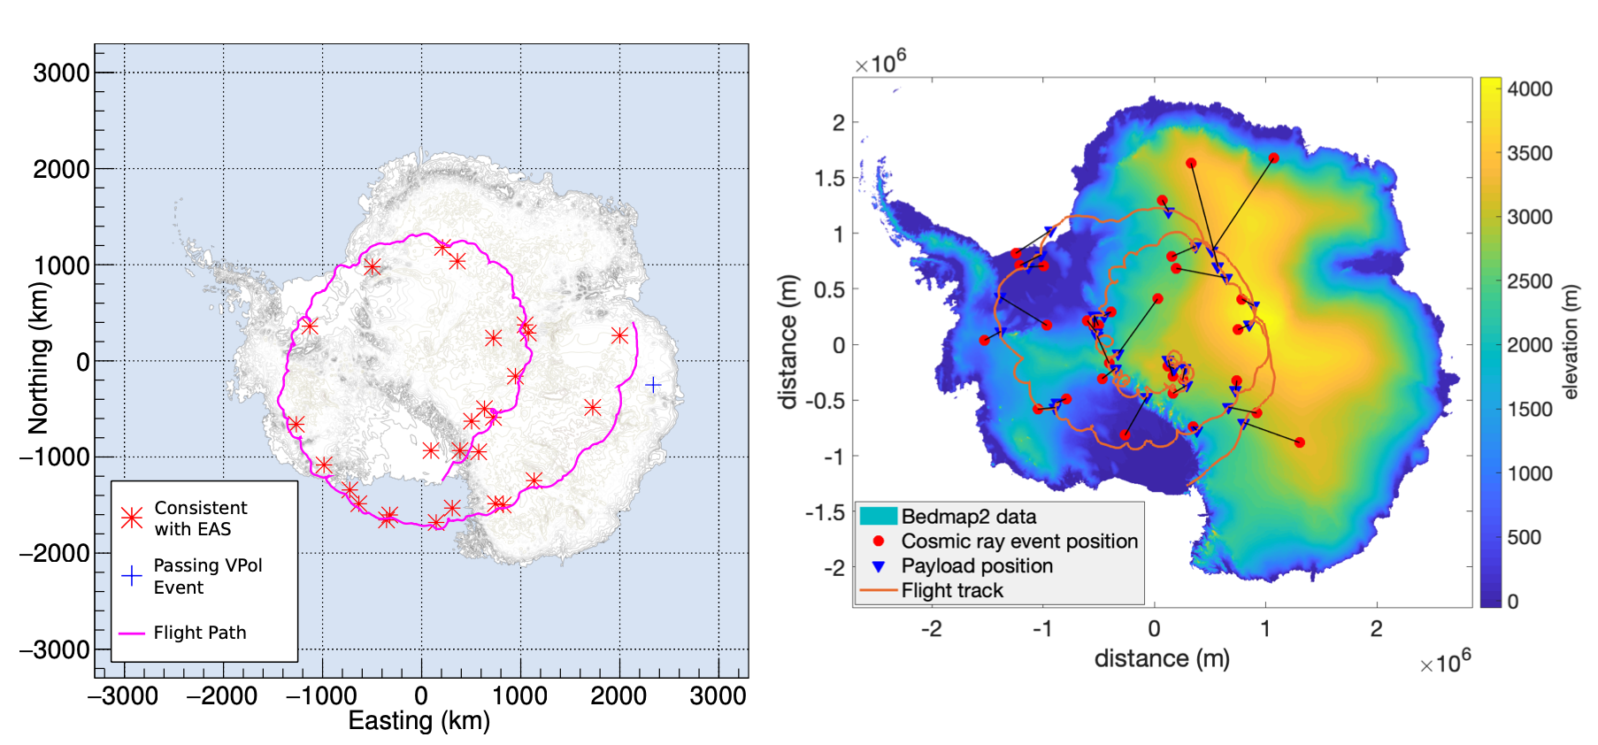
IV. ANITA (results)
ANtarctic Impulsive Transient Antenna (ANITA)
1 TeV 2.5*${10}^{11}$ cm.we
Left: A map of EAS events and the candidate Askaryan neutrino event from the most sensitive analysis of ANITA-III. Right: A map of EAS candidates from ANITA-IV.
Phys. Rev., D98(2)

Slide 27
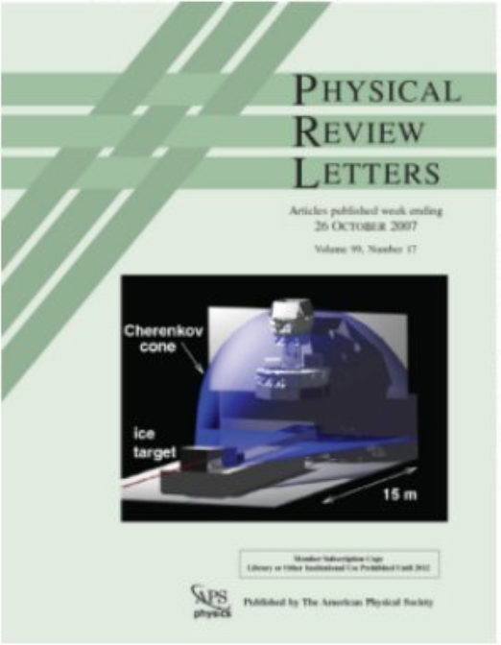
IV. ANITA
ANtarctic Impulsive Transient Antenna (ANITA)
Neutrino events
Cherenkov radiation
Askaryan Effect
ANITA
$$τ$$
$τ$ decay shower
<10m
Ice
$$ν_{τ}$$
hadronic shower
<10m

Slide 28
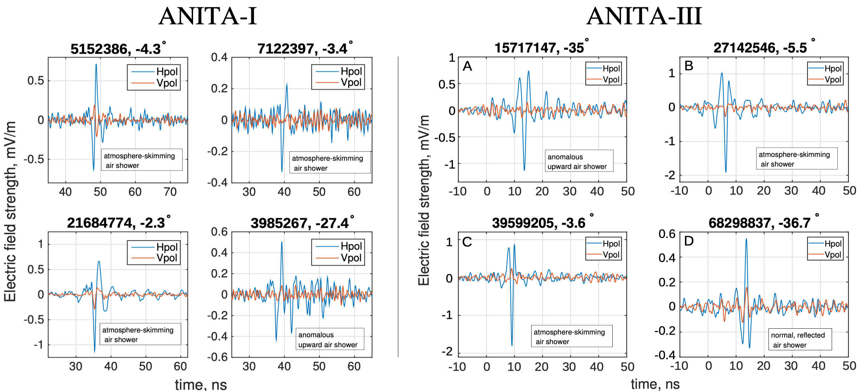
IV. ANITA
ANtarctic Impulsive Transient Antenna (ANITA)
1 TeV 2.5*${10}^{11}$ cm.we

Slide 29
IV. ANITA
Results:
ANITA observed direct UHECR events
ANITA observed reflected UHECR events
ANITA observed anomalous up-going direct events
Neutrino
Sterile neutrino
Boosted dark matter
Asymmetry dark matter ….

Slide 30
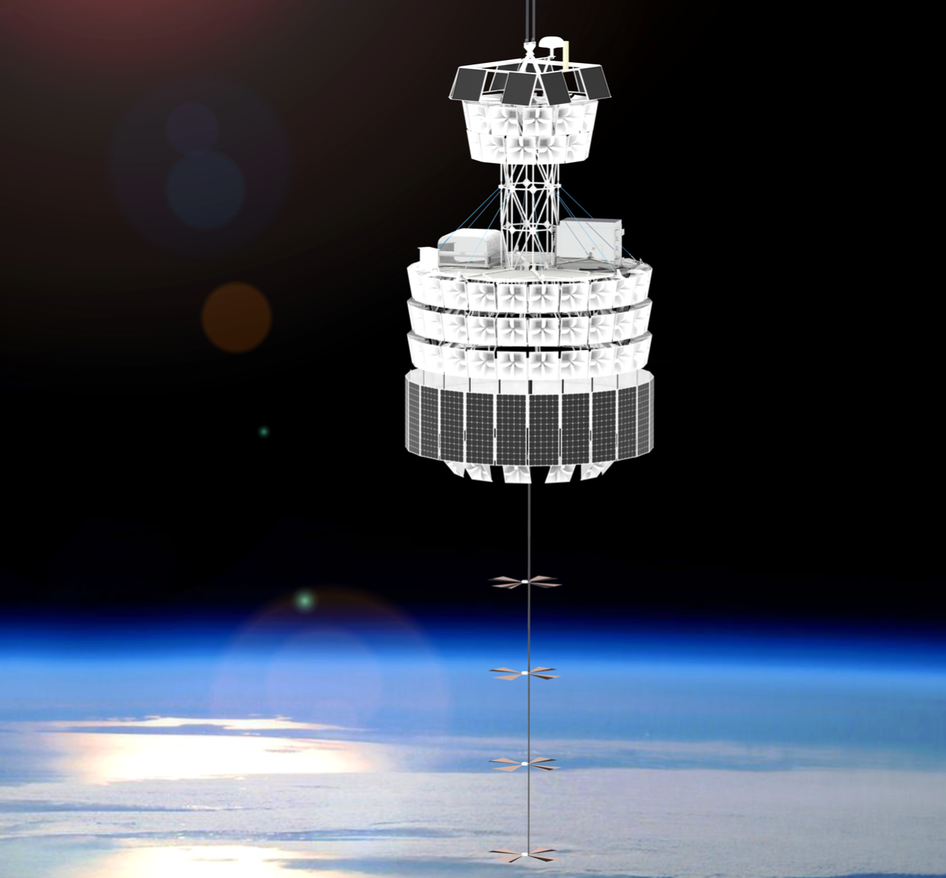
IV. ANITA
Puzzles & next step
The Payload for Ultrahigh Energy Observations
(PUEO)

